Slide 1
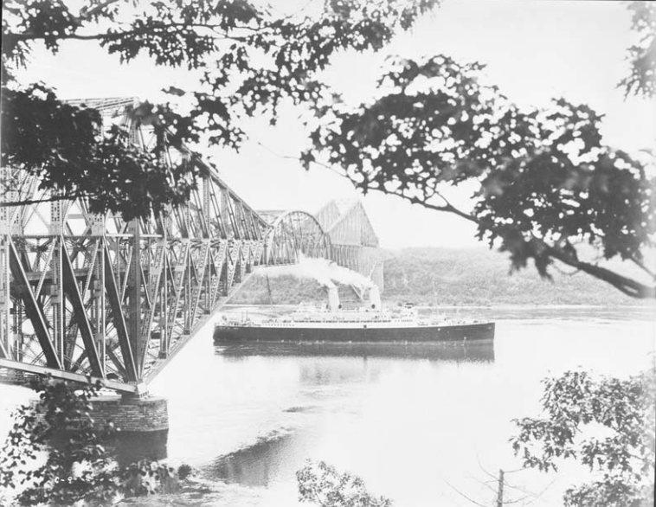
The Quebec Bridge Collapse

Slide 2

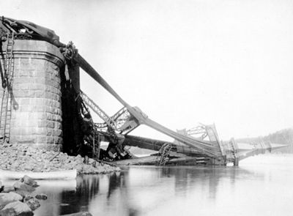
Background Information
The Quebec Bridge Company
St Lawrence River
Largest Bridge at the time
Started 1887
Collapsed in 1907
Flaws in design
Errors in Calculations

Slide 3
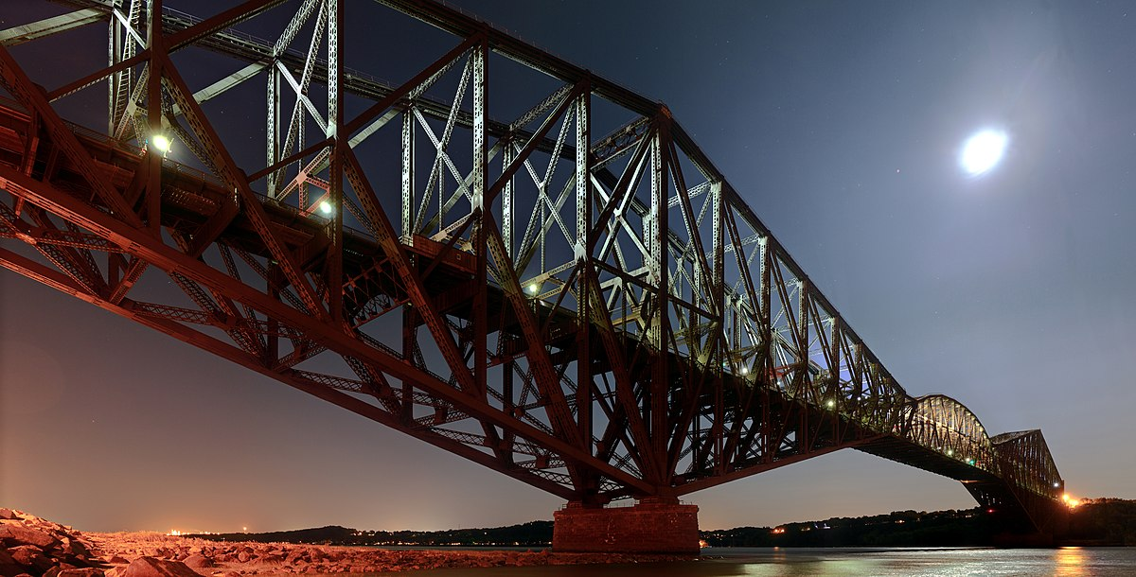
Continued
Second Attempt
Collapsed again on Sept 11, 1916
New Centre Span fell into river
Southwest Span fell pulling off supports
Finished in 1917

Slide 4
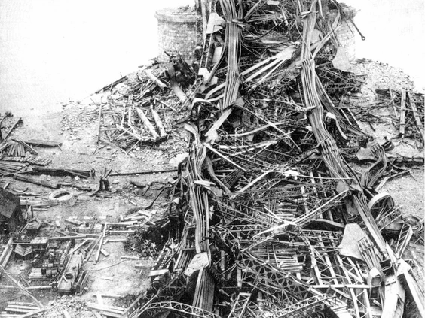
Impact
First collapse
75 workers killed, 11 injured
Metal debris fell into river
Second collapse
13 workers killed
Negatively impacted Quebec’s trade routes
Serves as a reminder as to how crucial leadership and proper communication is for a project

Slide 5
Breakdown Of Roles:
Abstract-(Bilal)
Introduction and background-(Bilal)
Analysis and investigation
Causes-(Hamza)
Impacts-(Adrian)
Ethics and professionalism-(Joaquin)
Recommendations-(Bilal)
Conclusion-(Adrian) (Hamza)
Acknowledgements (Tejveer)
References (Hamza)
Breakdown of duties and responsibilities (Tejveer)

Slide 6
Timeline:
Oct 20, 2021
Oct 23, 2021
Oct 24, 2021
Oct 26, 2021
Oct 27, 2021
Team Contract and Roles
Research
Extended Abstract
Presentation
Due Date
The Team contract is to be finished and roles are to be assigned to team members
Research for the assignment is to be finished
The Extended Abstract is to be completed using information from the research done
The Presentation is to be completed and all other aspects of the assignment are to be reviewed
The Team Contract, Extended Abstract and Presentation are to be submitted

Slide 7
Timeline:
Oct 27, 2021
Oct 29, 2021
Nov 1, 2021
Nov 2, 2021
Nov 3, 2021
Submission
Rough Drafts
Good Copy
Review
Due Date
Submit Extended abstract, presentation and team contract
Research for the assignment is to be finished
Good Copy to be completed
Edit and review good copy.
Submit the research paper

